Slide 1

Checklist: Lenacapavir
Step-by-Step Process
The INVITE-Home Study
Image by Ian Talmacs - CC0

Slide 2
Materials

Slide 3
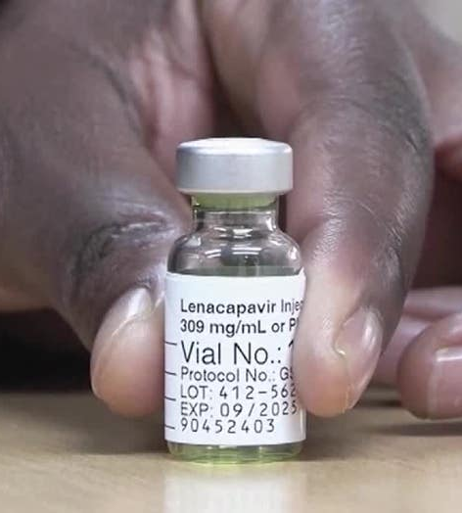
Step #1: Verify Prescription
Ensure the box contains lenacapavir and that the name on the kit matches the person receiving the injection.
Inside each box should be:
2 vials of lenacapavir (1.5ml each)
2 syringes
2 withdrawal needles (18 gauge, 1.5”)
2 injection needles (22 gauge, 0.5”)
3

Slide 4
Step #2: Gather and Organize
Supplies
Lenacapavir injection kit
Gloves
Alcohol swabs
Sterile gauze
Sterile pad
Adhesive bandages
Sharps disposal container
Location
Choose a well-lit area
Assemble all supplies on a clean, easily accessible surface
4

Slide 5
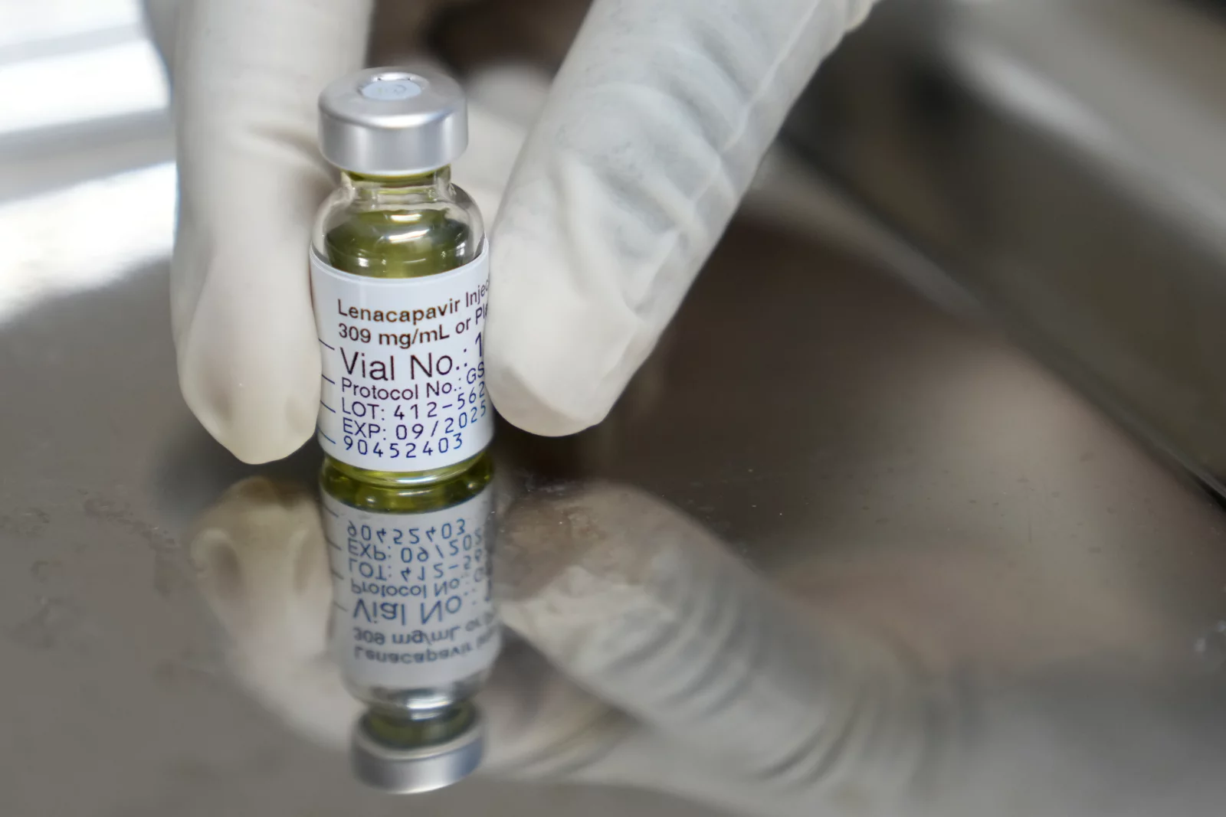
Step #3: Inspect Both Vials
Check the expiration date on both vials.
Do not use if expired.
Ensure medication is yellow and free from particles or discoloration.
If you notice any abnormalities, do not use it.
5

Slide 6


Step #4: WaSH Your HANDS AND PUT ON GLOVES
Wash hands and put on gloves.
Consider applying ice before injection at injection site to reduce pain.
6

Slide 7
Preparing the Injections
7

Slide 8
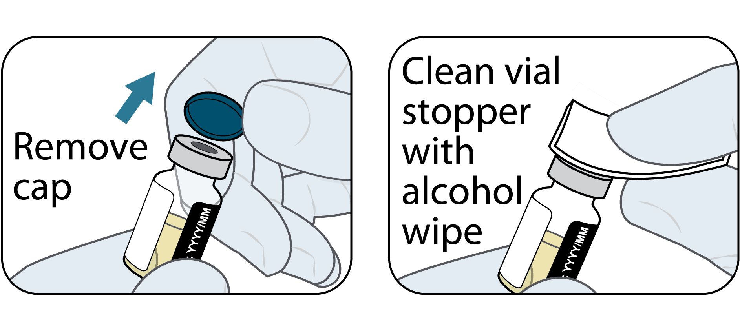
Step #5: Remove the vial cap
Remove the vial cap.
Vigorously wipe rubber stopper with an alcohol wipe.
Do not allow anything to touch the rubber stopper after wiping it.
8

Slide 9
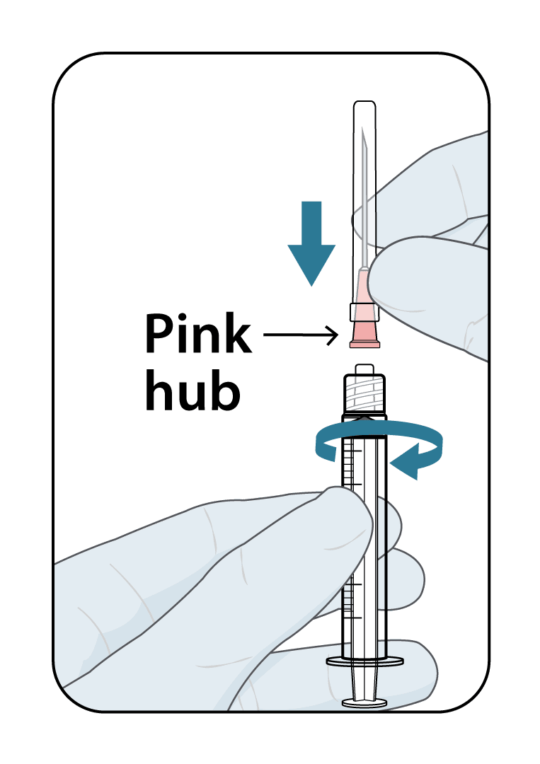
Step #6: Attach needle
Attach the 18-gauge, 1.5-inch pink withdrawal needle to the syringe.
9

Slide 10
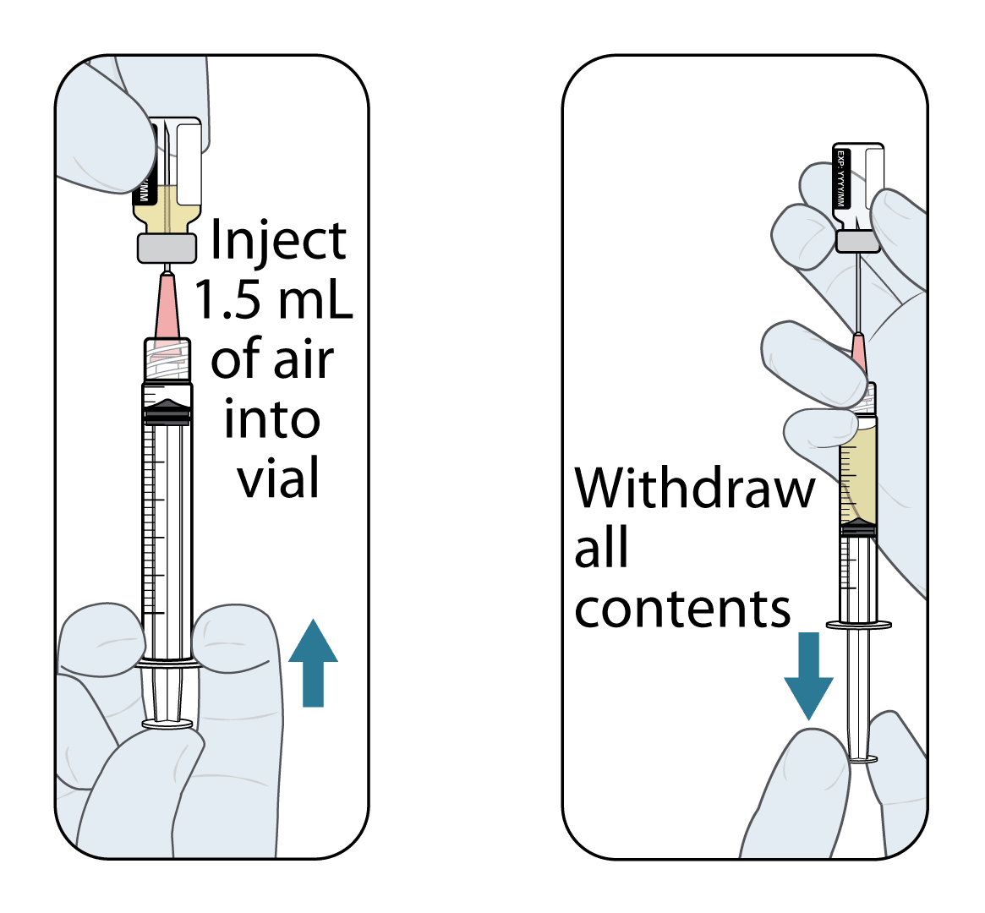
Step #7A: Inject air
Draw back 1.5 ml of air into the syringe.
Holding vial on a flat surface, insert needle into vial with rubber stopper.
Fully inject the 1.5ml of air by depressing plunger fully.
10

Slide 11
Step #7B: Draw Up Dose
Turn syringe and vial upside down and slowly withdraw as much of the medicine as possible into the syringe.
It’s okay to draw more medicine than the dose.
11

Slide 12
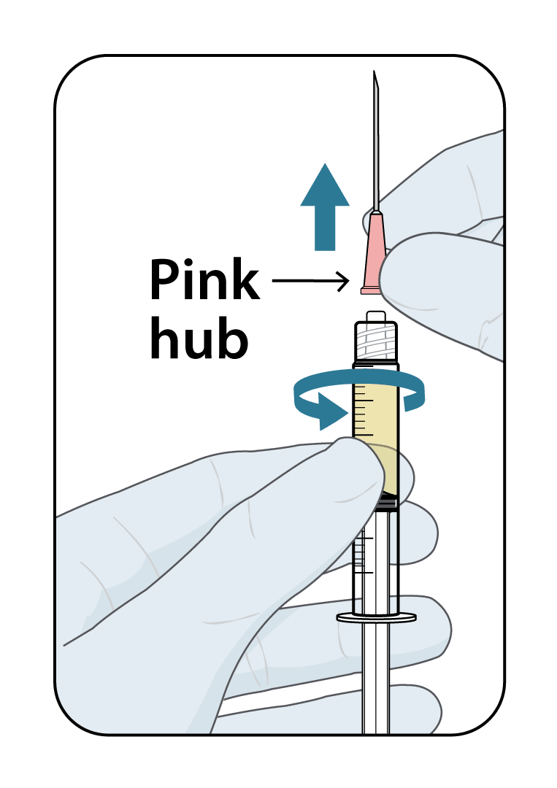
Step #8: Remove pink withdrawal needle
Remove withdrawal needle by pulling pink hub away from the syringe.
Dispose of withdrawal needle in sharps container.
12

Slide 13
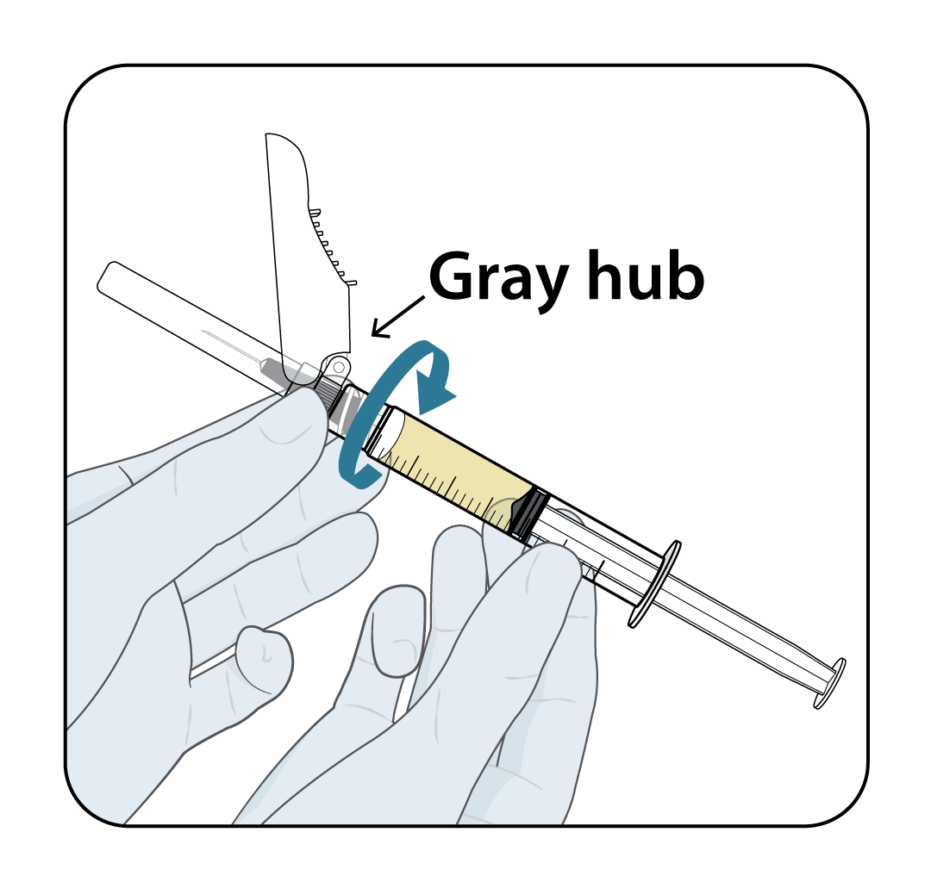
Step #9A: REPLACE with gray injection needle
Replace the pink drawing needle with the gray 22-gauge injection needle.
13

Slide 14
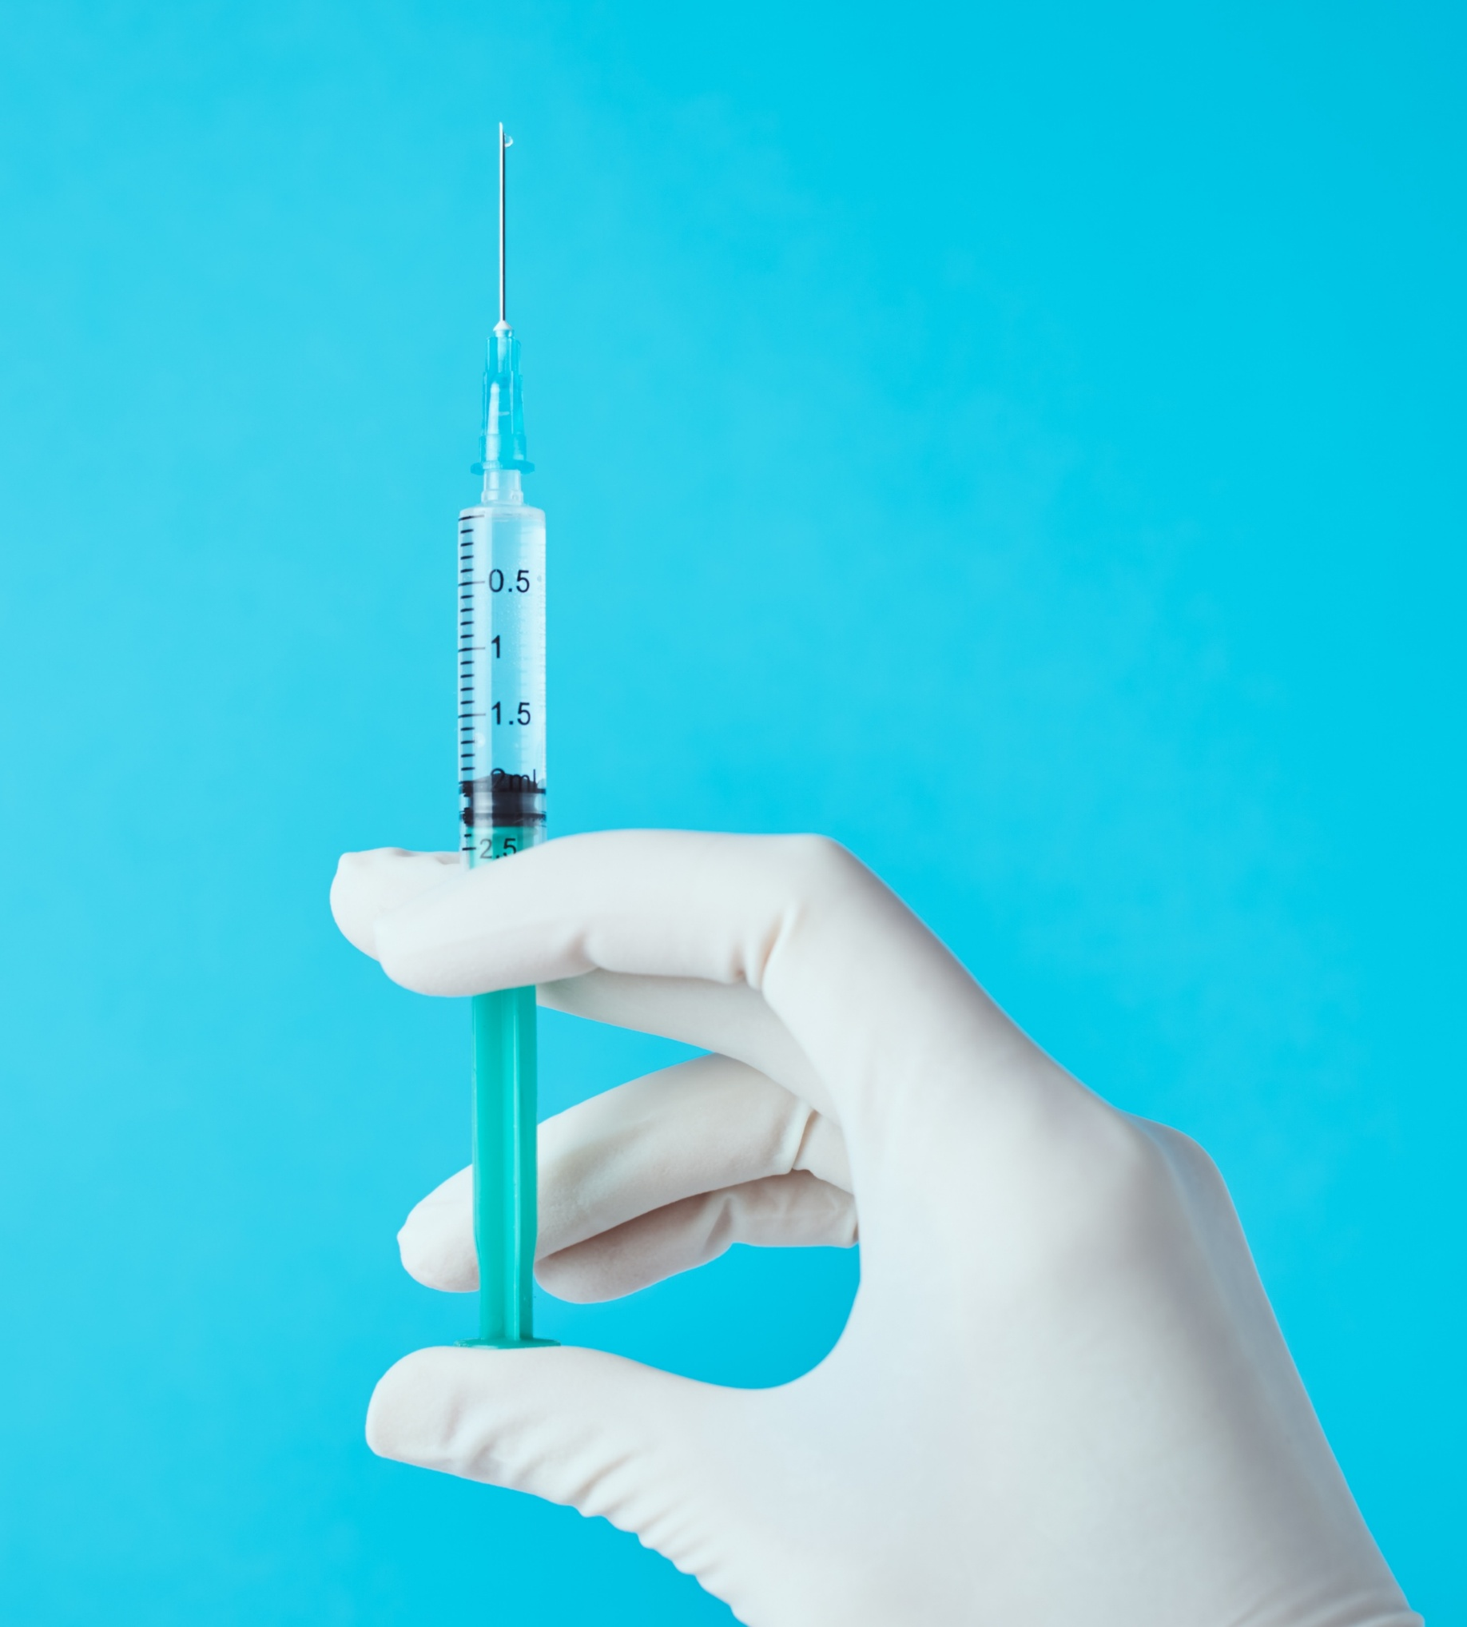
Step #9B: Prime needle
Prime needle by pushing liquid up to 1.5ml line and expelling any air bubbles and excess medication.
14

Slide 15
Administering the Injections

Slide 16
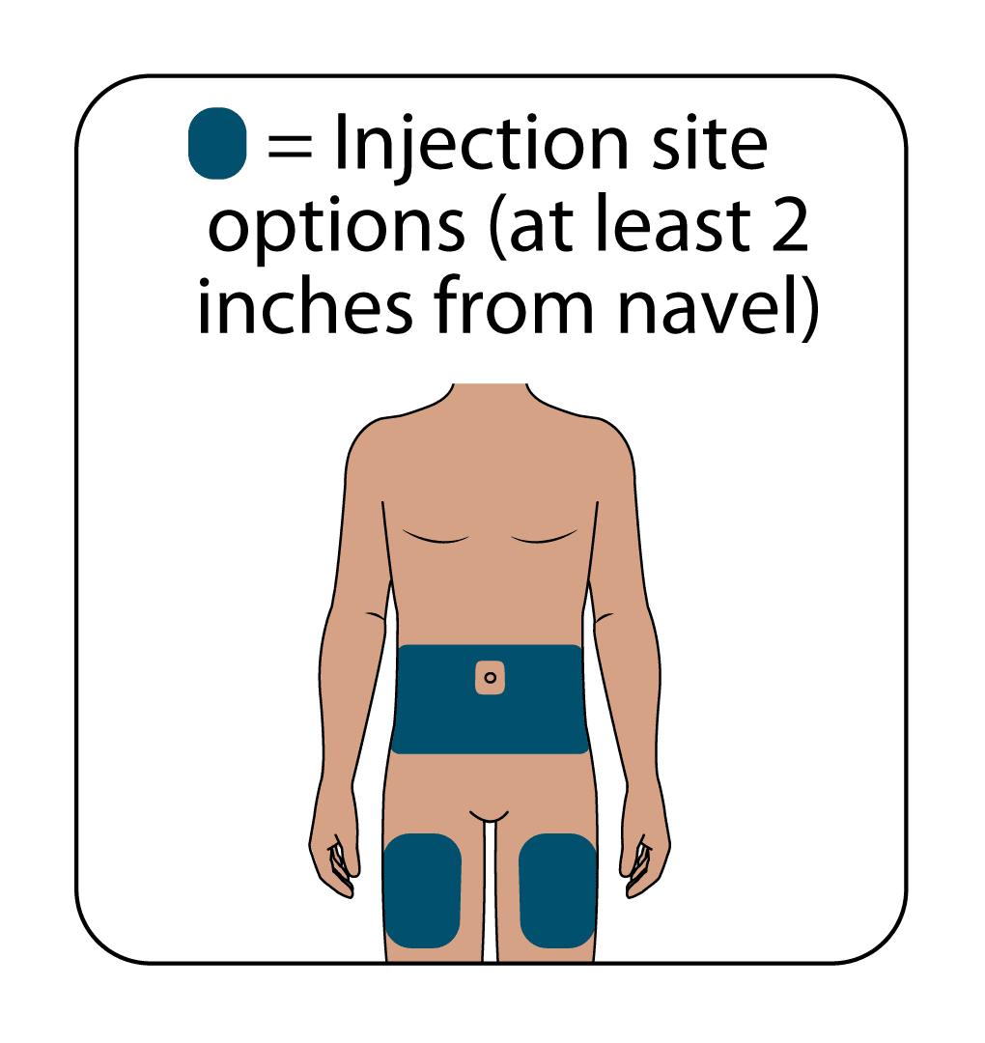
Step #10: Choose injection site
Abdomen, 2” from navel is recommended site.
Alternatively, thigh injections may be used if approved by provider.
2 injection sites should be at least 4 inches from each other.
Find a site that allows you to pinch enough skin to inject medication.
Areas with more body fat may give you more skin to pinch.
16

Slide 17
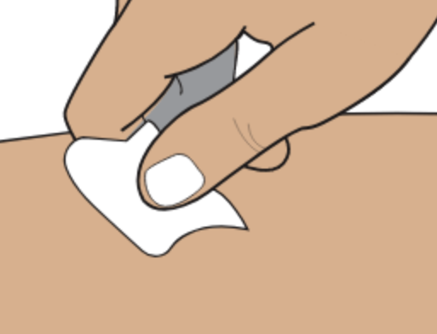
Step #11A: Prepare site
Clean injection site with an alcohol wipe in a circular motion moving from the center outward.
Allow to air dry.
17

Slide 18
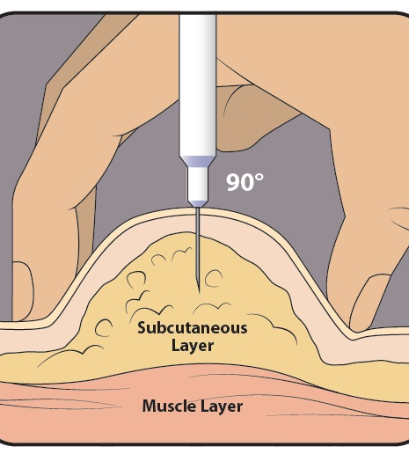
Step #11B: Pinch the skin
Gently pinch a broad portion of skin at the injection site.
Make sure the pinch is gentle to avoid injecting into compressed tissue.
18

Slide 19
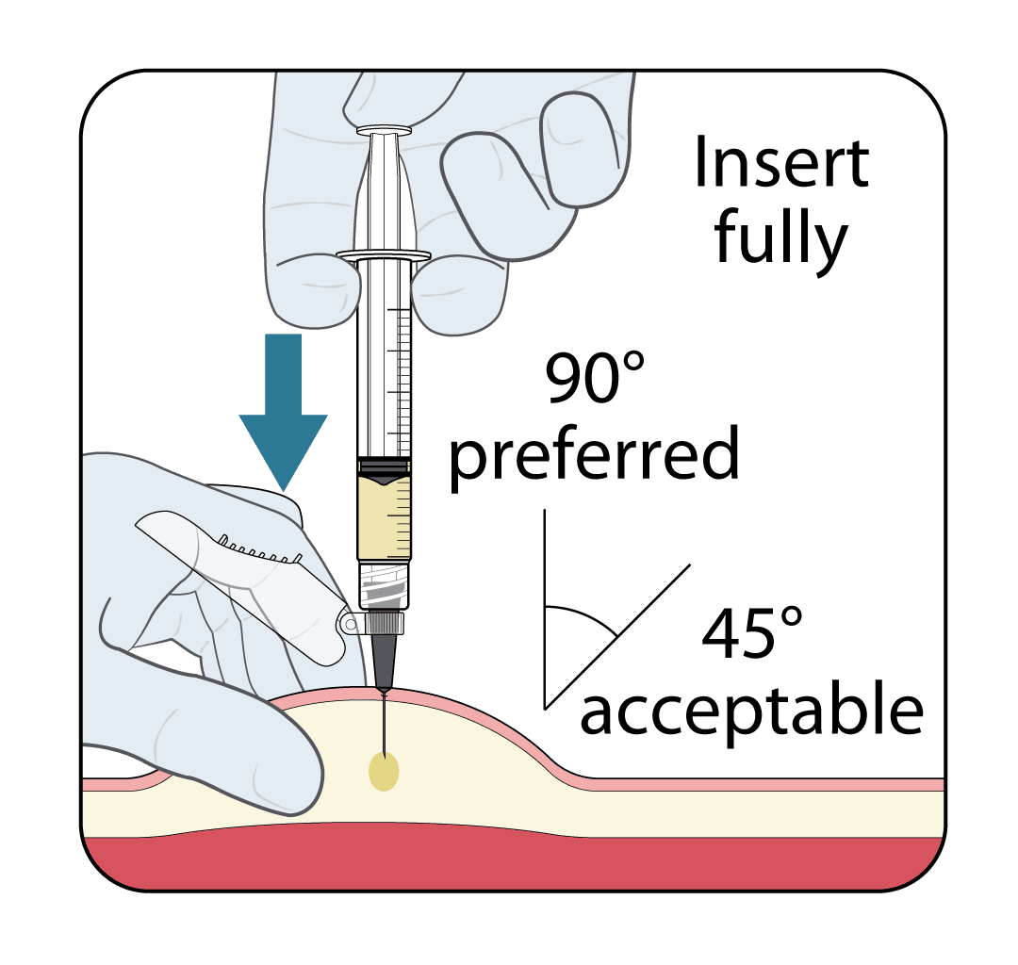
Step #11C: inject the medication
Fully insert needle at an angle between 45 and 90 degrees.
A 90-degree angle is preferred to help you inject into the subcutaneous layer.
19

Slide 20
Step #11D: Take it slow and steady
Depress plunger to inject solution.
Lenacapavir is a thick solution.
Inject at a slow and steady pace until all liquid in the syringe is fully dispensed.
20

Slide 21
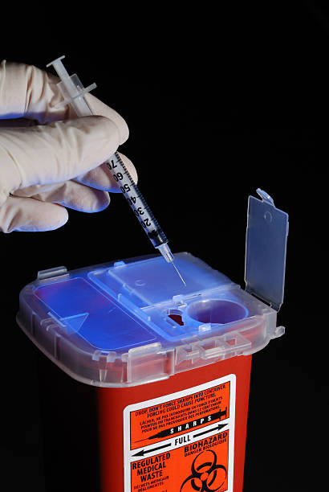
Step #12: Withdraw needle
Fully withdraw needle at the same angle that you inserted it.
Engage safety mechanism against a hard surface and immediately dispose of in sharps container.
21

Slide 22
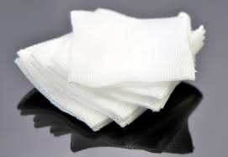
Step #13: Assess Site
Apply pressure to the site with gauze as needed for any residual solution or bleeding.
Apply a bandage if necessary.
22

Slide 23
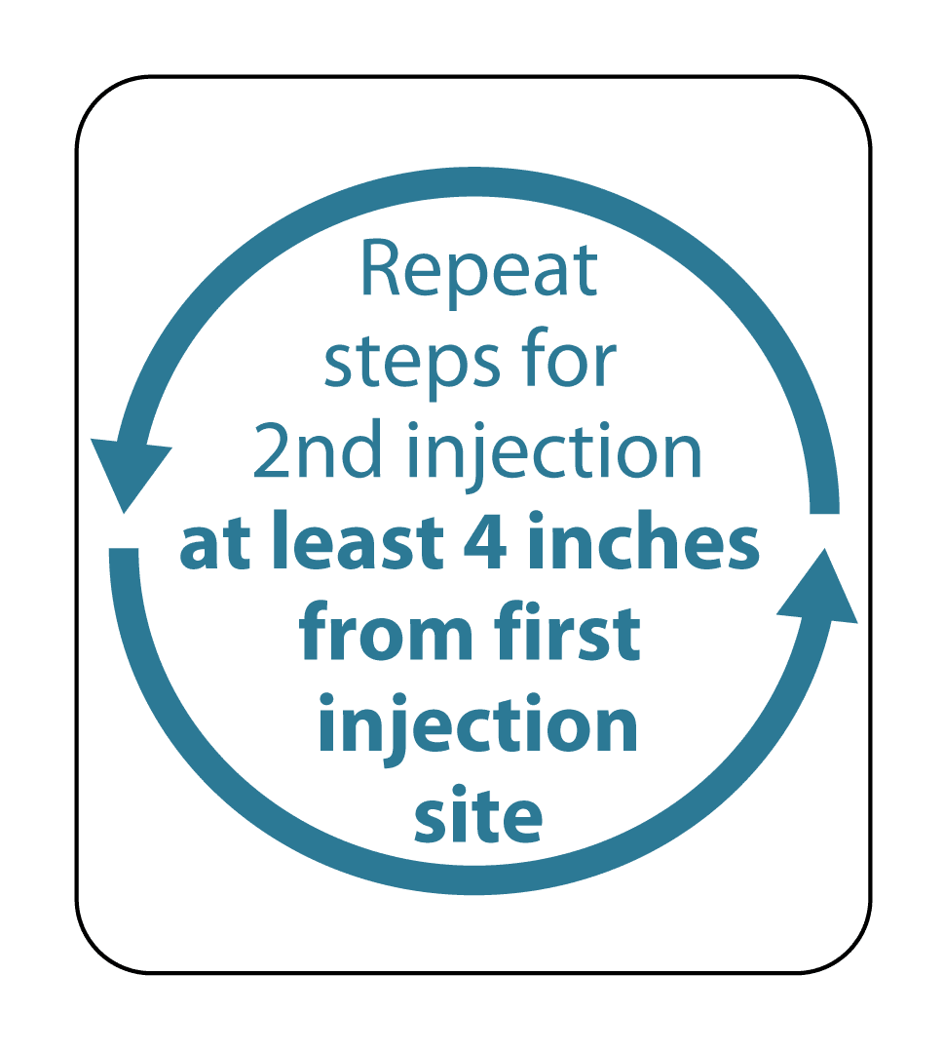
Step #14: Repeat steps 5-13
Repeat steps 5-13 for the other vial and inject at least 4 inches from the first injection site.
23

Slide 24
Post Injection
24

Slide 25

Injection Site Pain
Reduction Strategies
Ice site before and/or after injection.
Over-the-counter pain relievers such as acetaminophen or ibuprofen may be used if agreed upon previously with provider.
*Note: A nodule (hard bump) under the skin may be felt by most people after the injection and may last several months.
25

Slide 26
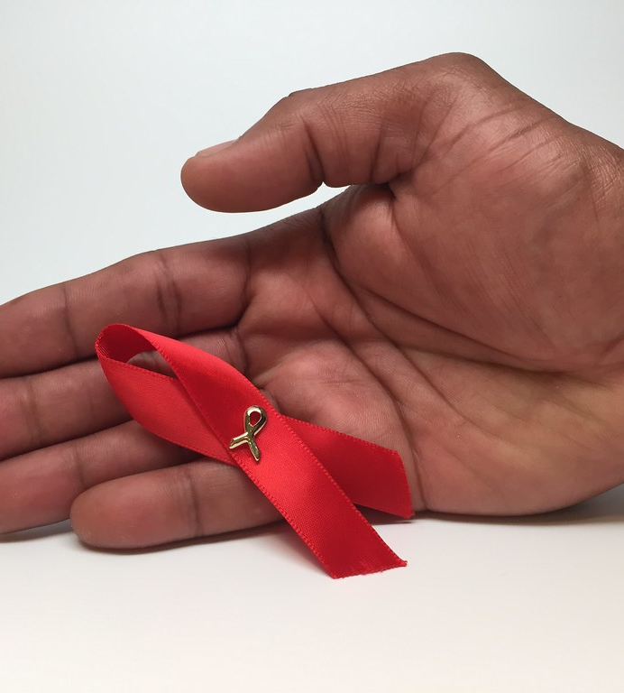
Thank you!
Contact us for more info
INVITE-Home@ucsf.edu
(415) 294-0609

